Slide 1
Classifying Images with Deep Convolutional Neural Networks
UNIT-III

Slide 2

History
In 1995, Yann LeCun and Yoshua Bengio introduced the concept of convolutional neural networks.

Slide 3
Convolution
1D (continuous, discrete) :
Input
∞
Kernel
f * g (x) =
∫ f (α )g(x −α )dα
α =−∞
N −1
Output is
=
∑
f (α )g(x −α )
sometimes called
α =0
Feature map
2D (continuous, discrete) :
∞ ∞
f * g (x, y) =
∫
∫ f (α , β )g(x −α , y − β )dαdβ
α =−∞ β =−∞
N −1 N −1
= ∑ ∑ f (α , β )g(x −α , y − β )
α =0 β =0

Slide 4
Convolution Properties
Commutative:
f*g = g*f
Associative:
(f*g)*h = f*(g*h)
Homogeneous:
f*(λg)= λ f*g
Additive (Distributive):
f*(g+h)= f*g+f*h
Shift-Invariant
f*g(x-x0,y-yo)= (f*g) (x-x0,y-yo)

Slide 5
ConvNet
ConvNet architectures for images:
fully-connected structure does not scale to large images
the explicit assumption that the inputs are images
allows us to encode certain properties into the architecture.
These then make the forward function more efficient to implement
Vastly reduce the amount of parameters in the network.
3D volumes: neurons arranged in 3 dimensions: width, height, depth.

Slide 6
Fully-connected layers in traditional neural networks can be inefficient for processing large images. Each neuron in a fully-connected layer is connected to every neuron in the previous layer, resulting in a large number of parameters and computational complexity.
ConvNets are specifically designed for processing grid-like data such as images. They take advantage of the spatial structure and correlation present in images, making them well-suited for tasks like image classification, object detection, and segmentation.
ConvNets are designed to capture hierarchical features in an image by using convolutional layers. These layers learn local patterns and progressively combine them to form complex, high-level features. This hierarchical feature extraction is crucial for recognizing patterns in images.

Slide 7
Convolutional layers in ConvNets are designed to exploit the local connectivity and shared weights, making the forward pass computationally more efficient compared to fully-connected layers. This design choice helps reduce the overall computational cost.
Convolutional layers use parameter sharing, which significantly reduces the number of parameters compared to fully-connected layers. This parameter sharing leverages the assumption that local patterns and features are useful across different spatial locations.
ConvNets have been highly successful in computer vision tasks due to their ability to automatically learn hierarchical features from images while efficiently handling the spatial structure of the data. This makes them a popular choice for tasks ranging from image classification to more complex tasks like object detection and segmentation.

Slide 8
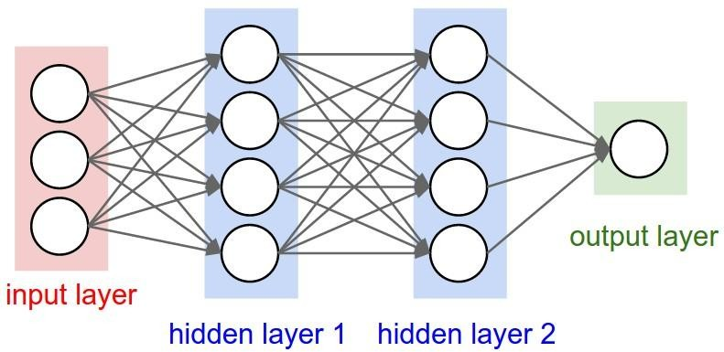
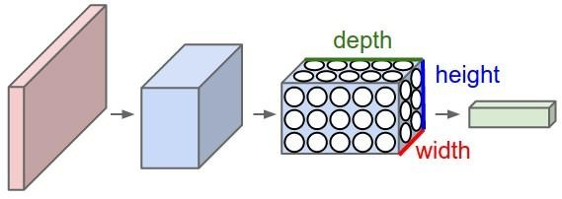
Convnets
Layers used to build ConvNets:
a stacked sequence of layers. 3 main types
Convolutional Layer, Pooling Layer, and Fully- Connected Layer
every layer of a ConvNet transforms one volume of activations to another through a differentiable function.

Slide 9
The replicated feature approach
Use many different copies of the
same feature detector with different positions.
Could also replicate across scale and orientation (tricky and expensive)
Replication greatly reduces the number of free parameters to be learned.
Use several different feature types, each with its own map of replicated detectors.
– Allows each patch of image to be represented in several ways.
The red connections all have the same weight.

Slide 11
Backpropagation with weight constraints
To constrain : w₁ =w₂
we need : Δw₁ =Δw₂
It’s easy to modify the backpropagation algorithm to incorporate linear constraints between the weights.
We compute the gradients as usual, and then modify the gradients so that they satisfy the constraints.
– So if the weights started off satisfying the constraints, they will continue to satisfy them.
∂E ∂E
compute :
and
∂w₁ ∂w₂
∂E ₊ ∂E
use
for w₁ and w₂
∂w₁ ∂w₂

Slide 12
What does replicating the feature detectors achieve?
Equivariant activities: Replicated features do not make the neural activities invariant to translation. The activities are equivariant.
representation by active neurons
translated representation
translated image
image
Invariant knowledge: If a feature is useful in some locations during training, detectors for that feature will be available in all locations during testing.

Slide 13
Pooling the outputs of replicated feature detectors
Get a small amount of translational invariance at each level by averaging four neighboring replicated detectors to give a single output to the next level.
This reduces the number of inputs to the next layer of feature extraction, thus allowing us to have many more different feature maps.
Taking the maximum of the four works slightly better.
Problem: After several levels of pooling, we have lost information about the precise positions of things.
This makes it impossible to use the precise spatial relationships between high-level parts for recognition.

Slide 15
Example Architecture for CIFAR-10
[INPUT - CONV - RELU - POOL - FC]
INPUT [32x32x3] : the raw pixel values of the image
CONV will compute the output of neurons that are connected to local regions in the input. With 12 filters, the output volume is [32x32x12]
RELU : apply an elementwise activation function, such as the max(0,x)
POOL will perform a downsampling operation along the spatial dimensions (width, height), resulting in volume such as [16x16x12].
FC layer will compute the class scores, resulting in volume of size [1x1x10], where each of the 10 numbers correspond to a class score, such as among the 10 categories of CIFAR-10

Slide 16
Convolution Layer
The Conv layer is the core building block of a CNN
The parameters consist of a set of learnable filters.
Every filter is small spatially (width and height), but extends through the full depth of the input volume, eg, 5x5x3
During the forward pass, we slide (convolve) each filter across the width and height of the input volume and compute dot products between the entries of the filter and the input at any position.
produce a 2-dimensional activation map that gives the responses of that filter at every spatial position.
Intuitively, the network will learn filters that activate when they see some type of visual feature
A set of filters in each CONV layer
each of them will produce a separate 2-dimensional activation map
We will stack these activation maps along the depth dimension and produce the output volume.

Slide 17
Convolutional Neural Network 2

Slide 18
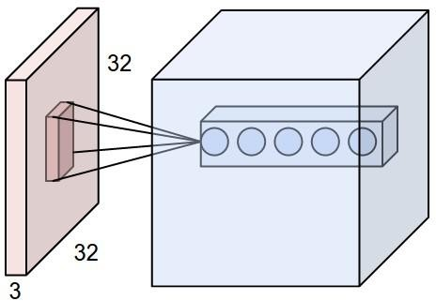
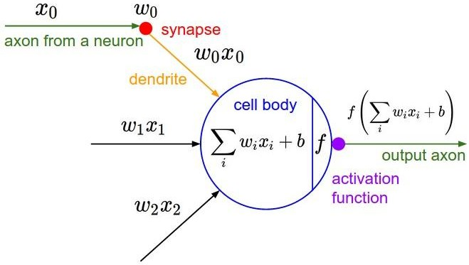
Convolution

Slide 20
Convolutions: More detail
32x32x3 image
32
height
32
depth
width
3
Andrej Karpathy

Slide 21
Convolutions: More detail
32x32x3 image
5x5x3 filter
32
Convolve the filter with the image
i.e. “slide over the image spatially,
computing dot products”
32
3
Andrej Karpathy

Slide 22


Convolutions: More detail
Convolution Layer
32x32x3 image
5x5x3 filter
32
1 number:
the result of taking a dot product between the
filter and a small 5x5x3 chunk of the image
(i.e. 5*5*3 = 75-dimensional dot product + bias)
32
3
Andrej Karpathy

Slide 23
Convolutions: More detail
Convolution Layer
32x32x3 image 5x5x3 filter
32
activation map
28
convolve (slide) over all spatial locations
32
28
3
1
Andrej Karpathy

Slide 24
Convolutions: More detail
Convolution Layer
consider a second, green filter
32x32x3 image
5x5x3 filter
activation maps
32
28
convolve (slide) over all spatial locations
32
28
3
1
Andrej Karpathy

Slide 25
Convolutions: More detail
For example, if we had 6 5x5 filters, we’ll get 6 separate activation maps:
activation maps
32
28
Convolution Layer
32
28
3
6
We stack these up to get a “new image” of size 28x28x6!
Andrej Karpathy

Slide 26
Convolutions: More detail
Preview: ConvNet is a sequence of Convolution Layers, interspersed with
activation functions
32
28
CONV, ReLU
e.g. 6 5x5x3 filters
32
28
3
6
Andrej Karpathy

Slide 27
Convolutions: More detail
Preview: ConvNet is a sequence of Convolutional Layers, interspersed with activation
functions
32
28
24
….
CONV, ReLU
e.g. 6 5x5x3 filters
CONV, ReLU
e.g. 10 5x5x6 filters
CONV, ReLU
32
28
24
3
6
10
Andrej Karpathy

Slide 28
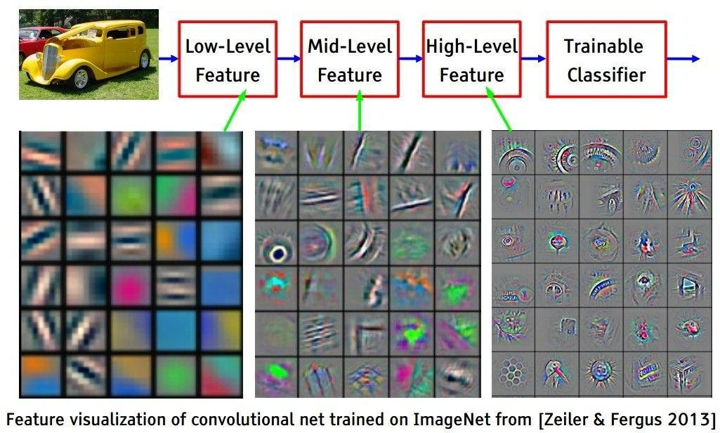
Convolutions: More detail
Preview
[From recent Yann LeCun slides]
Andrej Karpathy

Slide 29
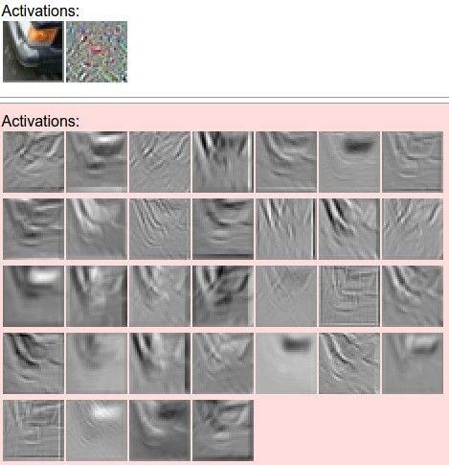
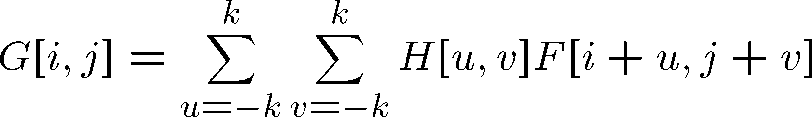
Convolutions: More detail
one filter => one activation map
example 5x5 filters
(32 total)
We call the layer convolutional because it is related to convolution of two signals:
elementwise multiplication and sum of a filter and the signal (image)
Adapted from Andrej Karpathy, Kristen Grauman

Slide 30
Convolutions: More detail
A closer look at spatial dimensions:
activation map
32x32x3 image 5x5x3 filter
32
28
convolve (slide) over all
spatial locations
32
28
3
1
Andrej Karpathy

Slide 31
Convolutions: More detail
A closer look at spatial dimensions:
7
7x7 input (spatially) assume 3x3 filter
•
7
Andrej Karpathy

Slide 32
Convolutions: More detail
A closer look at spatial dimensions:
7
7x7 input (spatially) assume 3x3 filter
•
7
Andrej Karpathy

Slide 33
Convolutions: More detail
A closer look at spatial dimensions:
•
7
7x7 input (spatially) assume 3x3 filter
•
7
Andrej Karpathy

Slide 34
Convolutions: More detail
A closer look at spatial dimensions:
•
7
7x7 input (spatially) assume 3x3 filter
•
7
Andrej Karpathy

Slide 35
Convolutions: More detail
A closer look at spatial dimensions:
7
 |  |  | •
7x7 input (spatially) assume 3x3 filter
=> 5x5 output
7
Andrej Karpathy

Slide 36
Convolutions: More detail
A closer look at spatial dimensions:
7
7x7 input (spatially) assume 3x3 filter applied with stride 2
7
Andrej Karpathy

Slide 37
Convolutions: More detail
A closer look at spatial dimensions:
7
7x7 input (spatially) assume 3x3 filter applied with stride 2
7
Andrej Karpathy

Slide 38
Convolutions: More detail
A closer look at spatial dimensions:
7
7x7 input (spatially) assume 3x3 filter applied with stride 2
=> 3x3 output!
7
Andrej Karpathy

Slide 39
Convolutions: More detail
A closer look at spatial dimensions:
7
7x7 input (spatially) assume 3x3 filter applied with stride 3?
7
Andrej Karpathy

Slide 40
Convolutions: More detail
A closer look at spatial dimensions:
7
7x7 input (spatially) assume 3x3 filter applied with stride 3?
7
doesn’t fit!
cannot apply 3x3 filter on 7x7 input with stride 3.
Andrej Karpathy

Slide 41
Convolutions: More detail
N
Output size:
(N - F) / stride + 1
 |  |  | F
 | F
e.g. N = 7, F = 3:
stride 1 => (7 - 3)/1 + 1 = 5
stride 2 => (7 - 3)/2 + 1 = 3
stride 3 => (7 - 3)/3 + 1 = 2.33 :\
N
Andrej Karpathy

Slide 42
Convolutions: More detail
In practice: Common to zero pad the border
0 | 0 | 0 | 0 | 0 | 0
0
0
0
0
e.g. input 7x7
3x3 filter, applied with stride 1
pad with 1 pixel border => what is the output?
(recall:)
(N - F) / stride + 1
Andrej Karpathy

Slide 43
Convolutions: More detail
In practice: Common to zero pad the border
0 | 0 | 0 | 0 | 0 | 0
0
0
0
0
e.g. input 7x7
3x3 filter, applied with stride 1
pad with 1 pixel border => what is the output?
7x7 output!
Andrej Karpathy

Slide 44
Convolutions: More detail
In practice: Common to zero pad the border
0 | 0 | 0 | 0 | 0 | 0
0
0
0
0
e.g. input 7x7
3x3 filter, applied with stride 1
pad with 1 pixel border => what is the output?
7x7 output!
in general, common to see CONV layers with stride 1, filters of size FxF, and zero-padding with (F-1)/2. (will preserve size spatially)
e.g. F = 3 => zero pad with 1 F = 5 => zero pad with 2 F = 7 => zero pad with 3
(N + 2*padding - F) / stride + 1
Andrej Karpathy

Slide 45
Convolutions: More detail
Examples time:
Input volume: 32x32x3
10 5x5 filters with stride 1, pad 2
Output volume size: ?
Andrej Karpathy

Slide 46
Convolutions: More detail
Examples time:
Input volume: 32x32x3
10 5x5 filters with stride 1, pad 2
Output volume size:
(32+2*2-5)/1+1 = 32 spatially, so
32x32x10
Andrej Karpathy

Slide 47
Convolutions: More detail
Examples time:
Input volume: 32x32x3
10 5x5 filters with stride 1, pad 2
Number of parameters in this layer?
Andrej Karpathy

Slide 48
Convolutions: More detail
Examples time:
Input volume: 32x32x3
10 5x5 filters with stride 1, pad 2
Number of parameters in this layer? each filter has 5*5*3 + 1 = 76 params
=> 76*10 = 760
(+1 for bias)
Andrej Karpathy

Slide 49
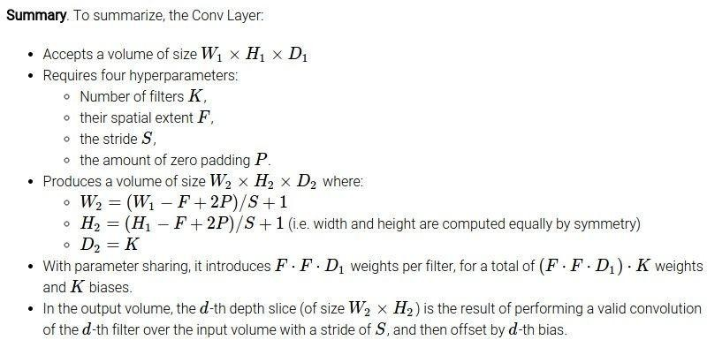
Convolutions: More detail
Andrej Karpathy

Slide 50
Spatial arrangement
Three hyperparameters control the size of the output volume
Depth: no of filters, each learning to look for something different in the input.
the stride with which we slide the filter.
pad the input volume with zeros around the border.

Slide 51
Spatial arrangement
We compute the spatial size of the output volume as a function of
the input volume size (W)
the receptive field size of the Conv Layer neurons (F)
the stride with which they are applied (S)
the amount of zero padding used (P) on the border.
The number of neurons that “fit” is given by (W−F+2P)/(S+1)
For a 7x7 input and a 3x3 filter with stride 1 and pad 0 we would get a 5x5 output.
With stride 2 we would get a 3x3 output.
Understanding and Calculating the number of Parameters in Convolution Neural Networks (CNNs) | by Rakshith Vasudev | Towards Data Science

Slide 52
Parameter Sharing
Parameter sharing controls the number of parameters.
If there are 55*55*96 = 290,400 neurons in the first Conv Layer, and each has 11*11*3 = 363 weights and 1 bias. Together, this adds up to 290400 * 364 = 105,705,600 parameters on the first layer of the ConvNet alone.
Reduce by parameter sharing
now have only 96 unique set of weights (one for each depth slice), for a total of 96*11*11*3 = 34,848 unique weights, or 34,944 parameters (+96 biases)
During backpropagation, every neuron in the volume will compute the gradient for its weights, but these gradients will be added up across each depth slice and only update a single set of weights per slice.

Slide 54
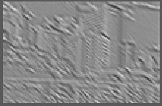
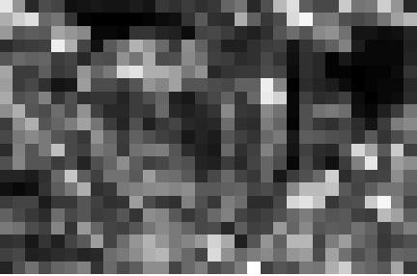
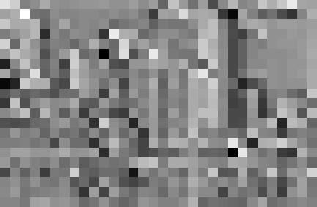
Spatial Pooling
Sum or max over non-overlapping / overlapping regions
Role of pooling:
Invariance to small transformations
Larger receptive fields (neurons see more of input)
Max
Sum
Adapted from Rob Fergus

Slide 55
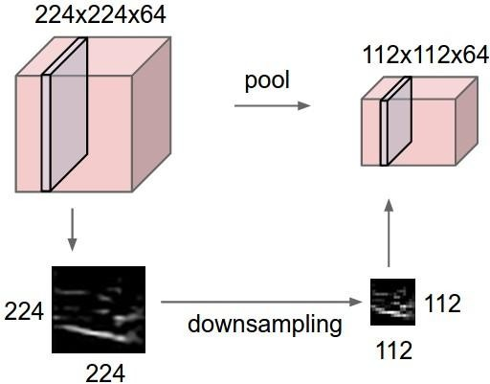
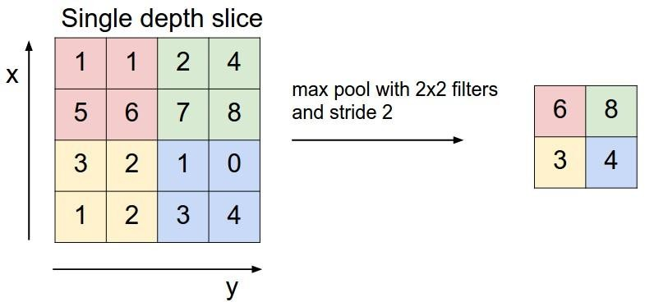
3. Spatial Pooling
Sum or max over non-overlapping / overlapping regions
Role of pooling:
Invariance to small transformations
Larger receptive fields (neurons see more of input)
Rob Fergus, figure from Andrej Karpathy

Slide 56
Pooling Layer
Insertion of pooling layer:
– reduce the spatial size of the representation
reduce the amount of parameters and computation in the network, and hence also control overfitting.
The Pooling Layer operates independently on every depth slice of the input and resizes it spatially, using the MAX operation.
The most common form is a pooling layer with filters of size 2x2 applied with a stride of 2 -- downsamples every depth slice in the input by 2 along both width and height,
MAX operation would in take a max over 4 numbers (little 2x2 region in some depth slice).
The depth dimension remains unchanged.

Slide 57
General pooling layer
Accepts a volume of size W1×H1×D1
Requires two hyperparameters:
their spatial extent F
the stride S
Produces a volume of size W2×H2×D2 where:
– W2=(W1−F)/S+1
– H2=(H1−F)/S+1
– D2=D1
Introduces zero parameters
Other pooling functions: Average pooling, L2- norm pooling

Slide 58
General pooling
Backpropagation. the backward pass for a max(x, y) operation routes the gradient to the input that had the highest value in the forward pass.
Hence, during the forward pass of a pooling layer you may keep track of the index of the max activation (sometimes also called the switches) so that gradient routing is efficient during backpropagation.

Slide 59
Fully-connected layer
Neurons in a fully connected layer have full connections to all activations in the previous layer
Their activations can hence be computed with a matrix multiplication followed by a bias offset.
Converting FC layers to CONV layers
the only difference between FC and CONV layers is that the neurons in the CONV layer are connected only to a local region in the input, and that many of the neurons in a CONV volume share parameters.
However, the neurons in both layers still compute dot products, so their functional form is identical.

Slide 60
Converting FC layers to CONV layers
For any CONV layer there is an FC layer that implements the same forward
function.
The weight matrix would be a large matrix that is mostly zero except for at certain blocks (due to local connectivity) where the weights in many of the blocks are equal (due to parameter sharing).
Conversely, any FC layer can be converted to a CONV layer.
For example, an FC layer with K=4096 that is looking at some input volume of size 7×7×512
can be equivalently expressed as a CONV layer with F=7,P=0,S=1,K=4096.
In other words, we are setting the filter size to be exactly the size of the input volume, and hence the output will simply be 1×1×4096 since only a single depth column “fits” across the input volume, giving identical result as the initial FC layer.

Slide 61
ConvNet Architectures
Layer Patterns
The most common architecture
stacks a few CONV-RELU layers,
follows them with POOL layers,
and repeats this pattern until the image has been merged spatially
to a small size.
At some point, it is common to transition to fully-connected layers. The last fully-connected layer holds the output, such as the class scores. In other words, the most common ConvNet architecture follows the pattern:
INPUT -> [[CONV -> RELU]*N -> POOL?]*M ->[FC -> RELU]*K -> FC
N >= 0 (and usually N <= 3), M >= 0, K >= 0

Slide 62
three layers of 3x3 CONV vs a single CONV layer with 7x7 receptive fields.
Prefer a stack of small filter CONV to one large receptive field CONV layer.
The receptive field size is identical in spatial extent (7x7), but with several disadvantages.
The neurons would be computing a linear function over the input, while the three stacks of CONV layers contain non-linearities that make their features more expressive.
If we suppose that all the volumes have C channels, the single 7x7 CONV layer would contain C×(7×7×C)=49C² parameters, while the three 3x3 CONV layers would contain 3×(C×(3×3×C))=27C² parameters.
Intuitively, stacking CONV layers with tiny filters as opposed to having one CONV layer with big filters allows us to express more powerful features of the input, and with fewer parameters.

Slide 63
Practical matters

Slide 64
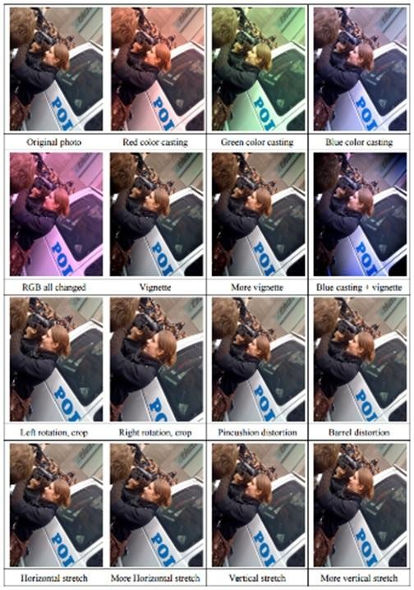
Data Augmentation (Jittering)
Create virtual trainin
Horizontal flip
Random crop
Color casting
Geometric distortion
g samples
Deep Image [Wu et al. 2015]
Jia-bin Huang

Slide 65
Transfer Learning
“You need a lot of a data if you want to train/use CNNs”
Andrej Karpathy

Slide 66
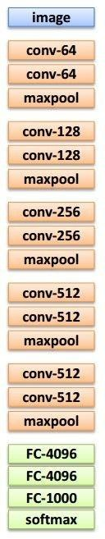
Transfer Learning with CNNs
Source: classification on ImageNet Target: some other task/data
1. Train on ImageNet
2. Small dataset:
3. Medium dataset:
finetuning
more data = retrain more of
the network (or all of it)
Freeze these
Freeze these
Train this
Train this
Another option: use network as feature extractor, train SVM on extracted features for target task
Adapted from Andrej Karpathy

Slide 67
Transfer Learning with CNNs
 | very similar dataset | very different dataset
very little data | Use linear classifier on top layer | You’re in trouble… Try linear classifier from different stages
quite a lot of data | Finetune a few layers | Finetune a larger number of layers
more generic
more specific
Andrej Karpathy

Slide 68
Image Segmentation
Segmentation divides an image into its constituent regions or objects.
Segmentation of images is a difficult task in image processing. Still under research.
Segmentation allows to extract objects in images.
Segmentation is unsupervised learning.
Model based object extraction, e.g., template matching, is supervised learning.

Slide 69
What it is useful for
After a successful segmenting the image, the contours of objects can be extracted using edge detection and/or border following techniques.
Shape of objects can be described.
Based on shape, texture, and color objects can be identified.
Image segmentation techniques are extensively used in similarity searches, e.g.:
http://elib.cs.berkeley.edu/photos/blobworld/

Slide 70
Segmentation Algorithms
Segmentation algorithms are based on one of two basic properties of color, gray values, or texture: discontinuity and similarity.
First category is to partition an image based on abrupt changes in intensity, such as edges in an image.
Second category are based on partitioning an image into regions that are similar according to a predefined criteria. Histogram thresholding approach falls under this category.

Slide 71
Domain spaces
spatial domain (row-column (rc) space)
histogram spaces
color space
texture space
other complex feature space

